Slide 1

NATURAL LANGUAGE PROCESSING
Experiment 3: To understand and implement Stop word removal
Experiment by Riya Gupta(8339) Dishank Oza(8355)

Slide 2

What Are STOPWORDS?
Stopwords are the words in any language which does not add much meaning to a sentence. They can safely be ignored without sacrificing the meaning of the sentence. For some search engines, these are some of the most common, short function words, such as the, is, at, which, and on. In this case, stop words can cause problems when searching for phrases that include them, particularly in names such as “The Who” or “Take That”.
Example: “what is a stop word?”
Output: “stop word”

Slide 3

Problematic Example
“I told you that she was not happy”
The result would be [‘told’, ‘happy’].
Word importance may vary depending on the dataset. But it may also change depending on the goal you are trying to achieve. Problems like sentiment analysis are much more sensitive to stop words removal than document classification.

Slide 4
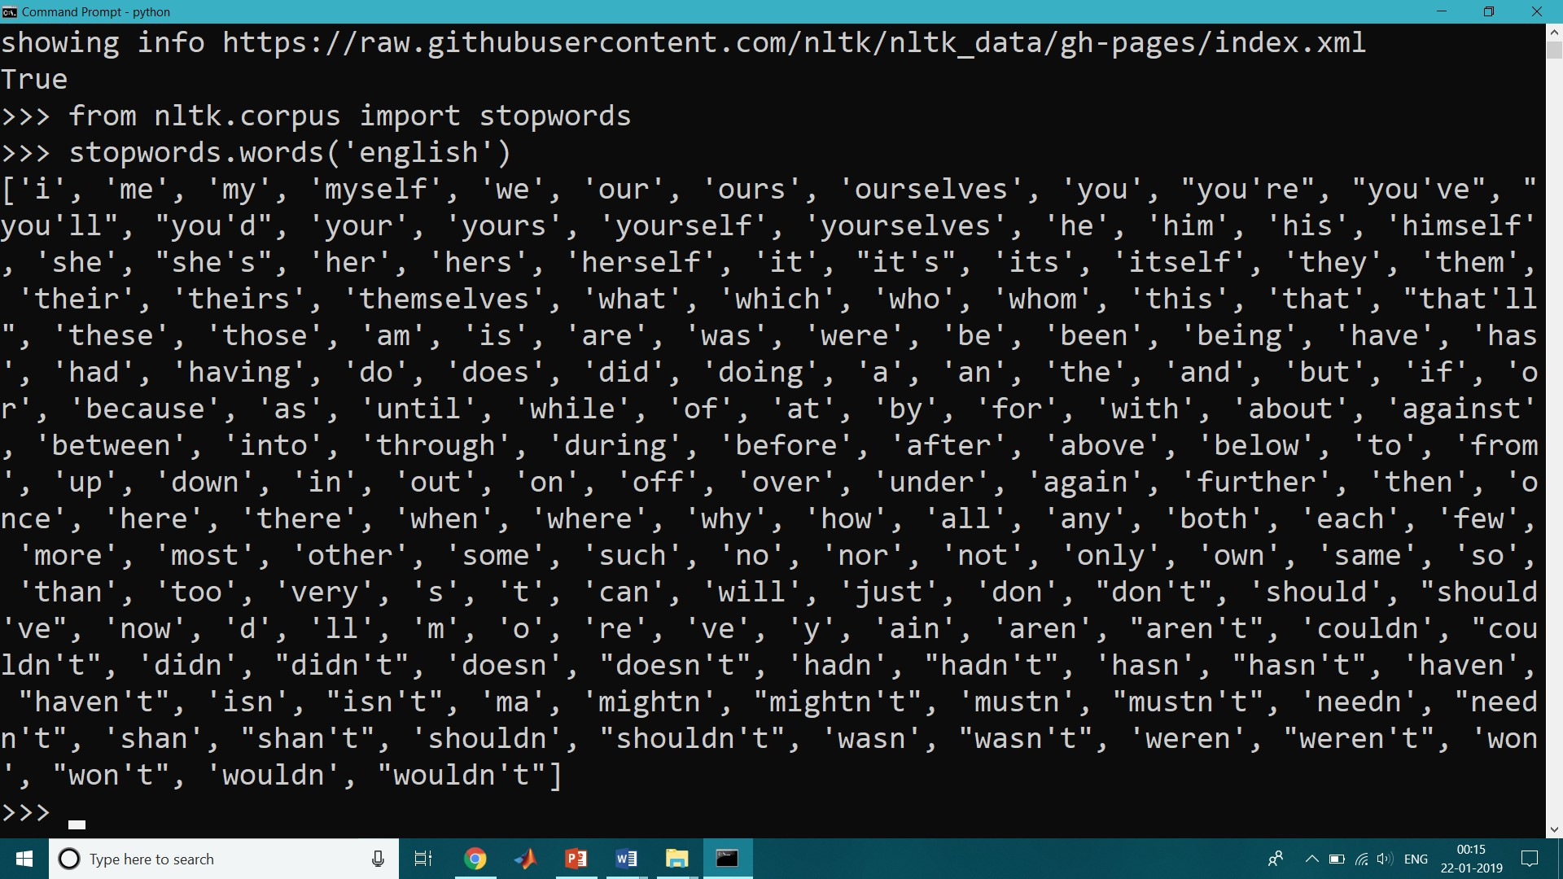
So when to remove stop words?
There is no hard and fast rule on when to remove stop words. But I would suggest removing stop words if our task to be performed is one of Language Classification, Spam Filtering, Caption Generation, Auto-Tag Generation, Sentiment analysis, or something that is related to text classification.
On the other hand, if our task is one of Machine Translation, Question-Answering problems, Text Summarization, Language Modeling, it’s better not to remove the stop words as they are a crucial part of these applications.

Slide 5

Pros and cons?
Pros and Cons:
One of the first things that we ask ourselves is what are the pros and cons of any task we perform. Let’s look at some of the pros and cons of stop word removal in NLP.
pros: * Stop words are often removed from the text before training deep learning and machine learning models since stop words occur in abundance, hence providing little to no unique information that can be used for classification or clustering. * On removing stopwords, dataset size decreases, and the time to train the model also decreases without a huge impact on the accuracy of the model. * Stopword removal can potentially help in improving performance, as there are fewer and only significant tokens left. Thus, the classification accuracy could be improved
cons: Improper selection and removal of stop words can change the meaning of our text. So we have to be careful in choosing our stop words.
LOOKING AHEAD

Slide 6

How to remove stop words???
Using NLTK library
Using SpaCy Library
Using Gensim Library
Custom stop words

Slide 7
THANK YOU

